Slide 1
Geospatial Infrastructure and Open Innovation
2016-11-09 JICA NSDI Seminar
2016-11-14 SSGCC
Hidenori FUJIMURA
GSI International
Photo by Junkichi Egashira, llicensed under CC BY 4.0 International

Slide 2

Hello
Director,
International Affairs Division, GSI
Head of Delegation,
Japan to ISO/TC 211
Leader,
ICT Advisory Team, GSI
github.com/hfu
facebook

Slide 3

Geospatial Information Authority of Japan (GSI)
We’re Japan’s National Geospatial Information Authority

Slide 4
Topics
coordination
ownership
involvement

Slide 5
coordination
(to be filled out later)

Slide 6
ownership
we broke down our contribution to NSDI into 3 components.
ownership and involvement matters, to implement NSDI.
NSDI
National Spatial Data Infrastructure
Geospatial Society
Various application by open innovation
Disaster Response as the Moment of Truth
(1) GNSS CORS Infrastructure
(2) Institutional Arrangement
(3) Web Maps
Geospatial Infrastructure
Open data service, often by open source software

Slide 7
involvement
We involve ourselves and our partners in:
Open Data
We follow the Open Data Policy of the Government of Japan (compatible with CC-BY)
In addition, Survey Act applies to core data.
Open Source
We use Open Source for lowering running cost and for promoting development of domain-specific applications.
We also develop open source software available at GitHub.
Open Innovation
We run a community of geospatial developers who use our data – GSI Maps Partner Network.
We participate in existing community events such as FOSS4G Tokyo/Kansai, Code for Japan Summit, and GitHub Universe.

Slide 8
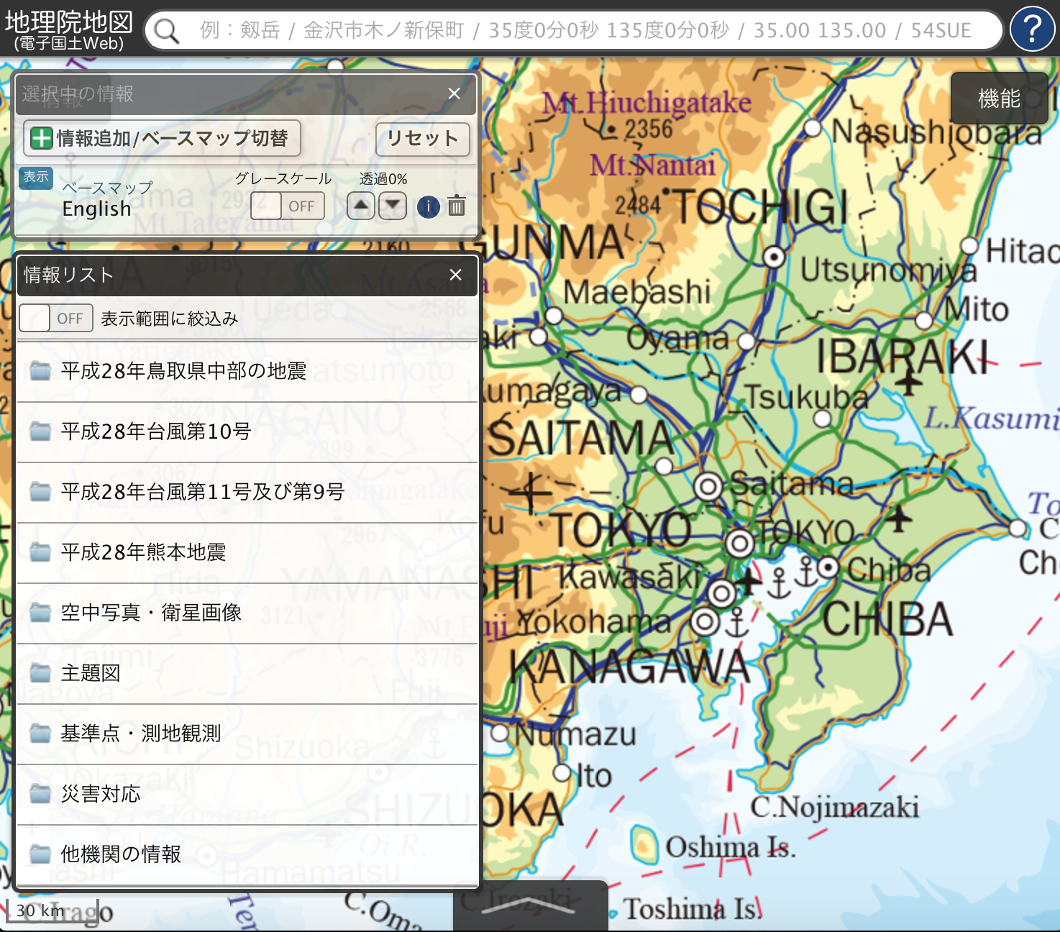
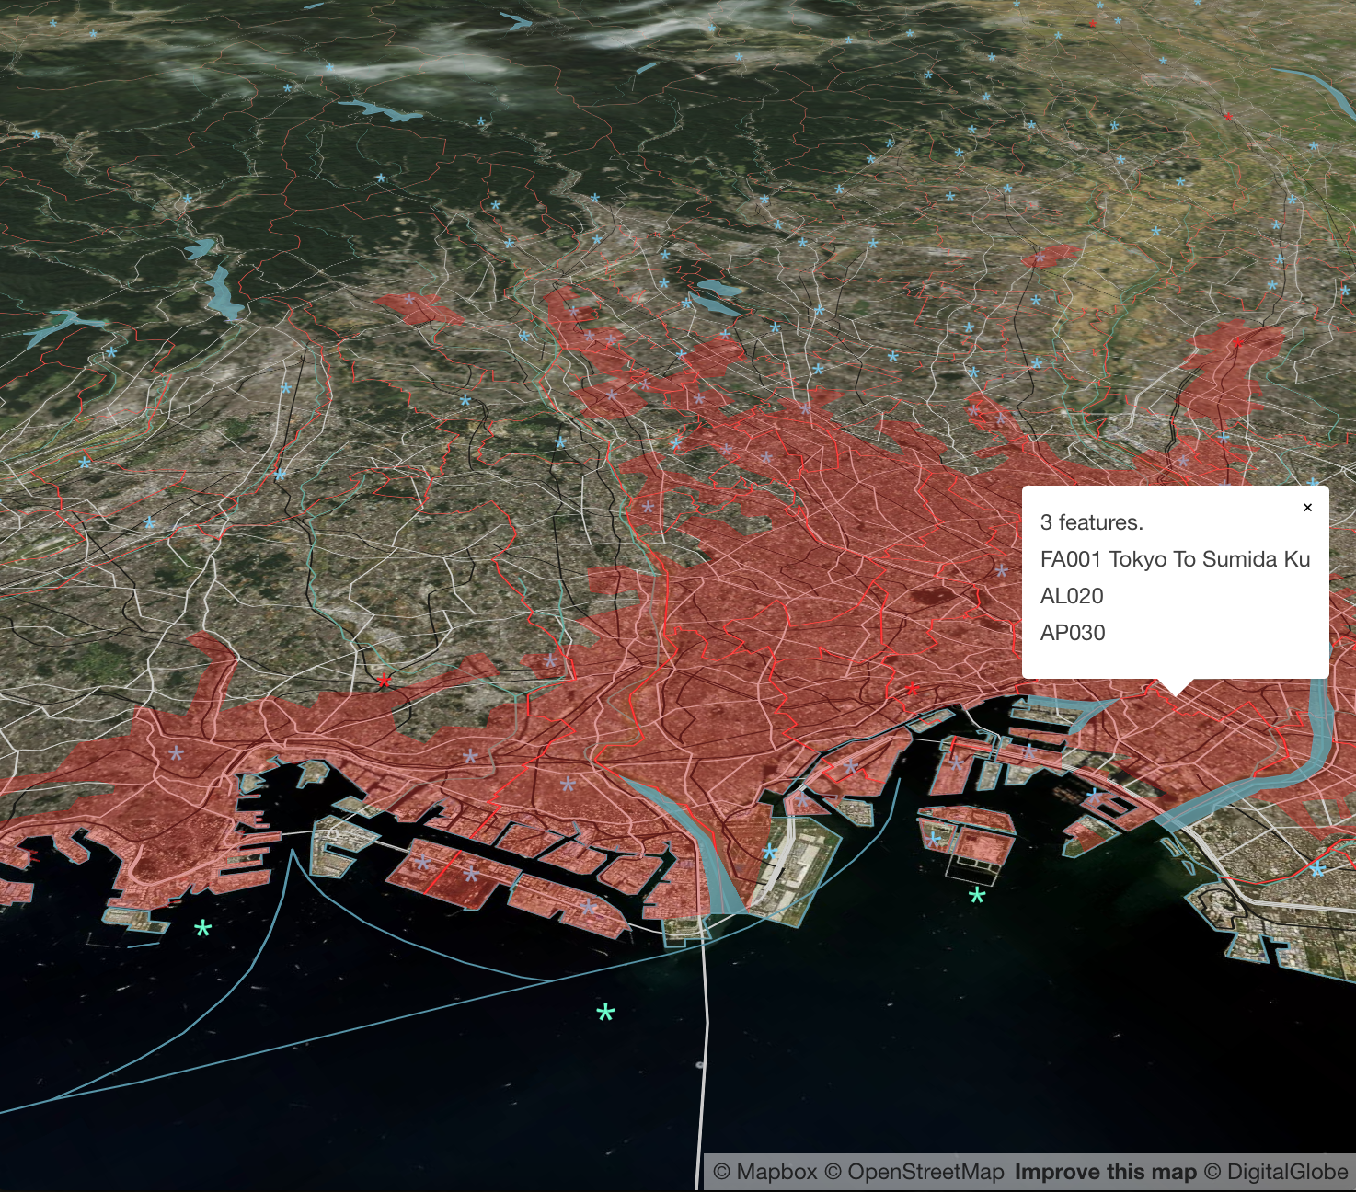
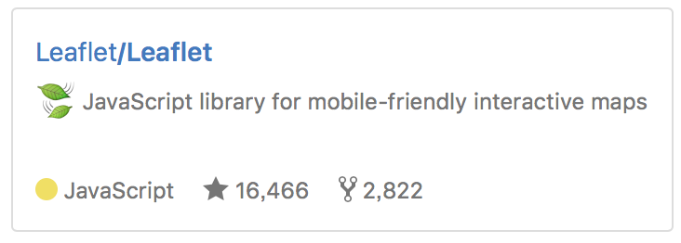

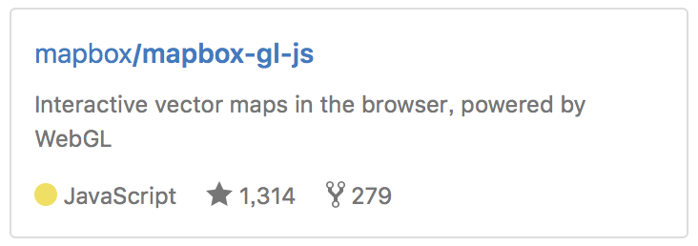
We import great open source software developed also in Ukraine
http://maps.gsi.go.jp/
Our geoportal “GSI Maps” provides approximately 1,600 layers as tiles or GeoJSON files.
http://bit.ly/tokyo-vt
Global Map data in binary vector tiles, to promote wider application (in development.)

Slide 9
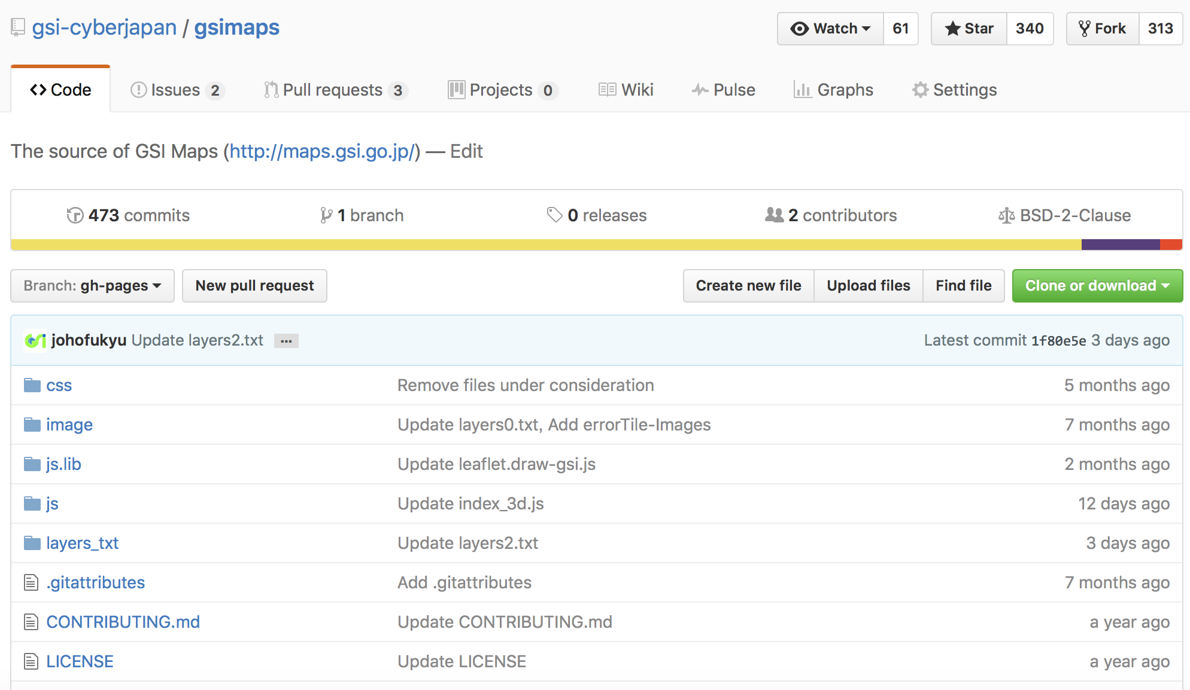
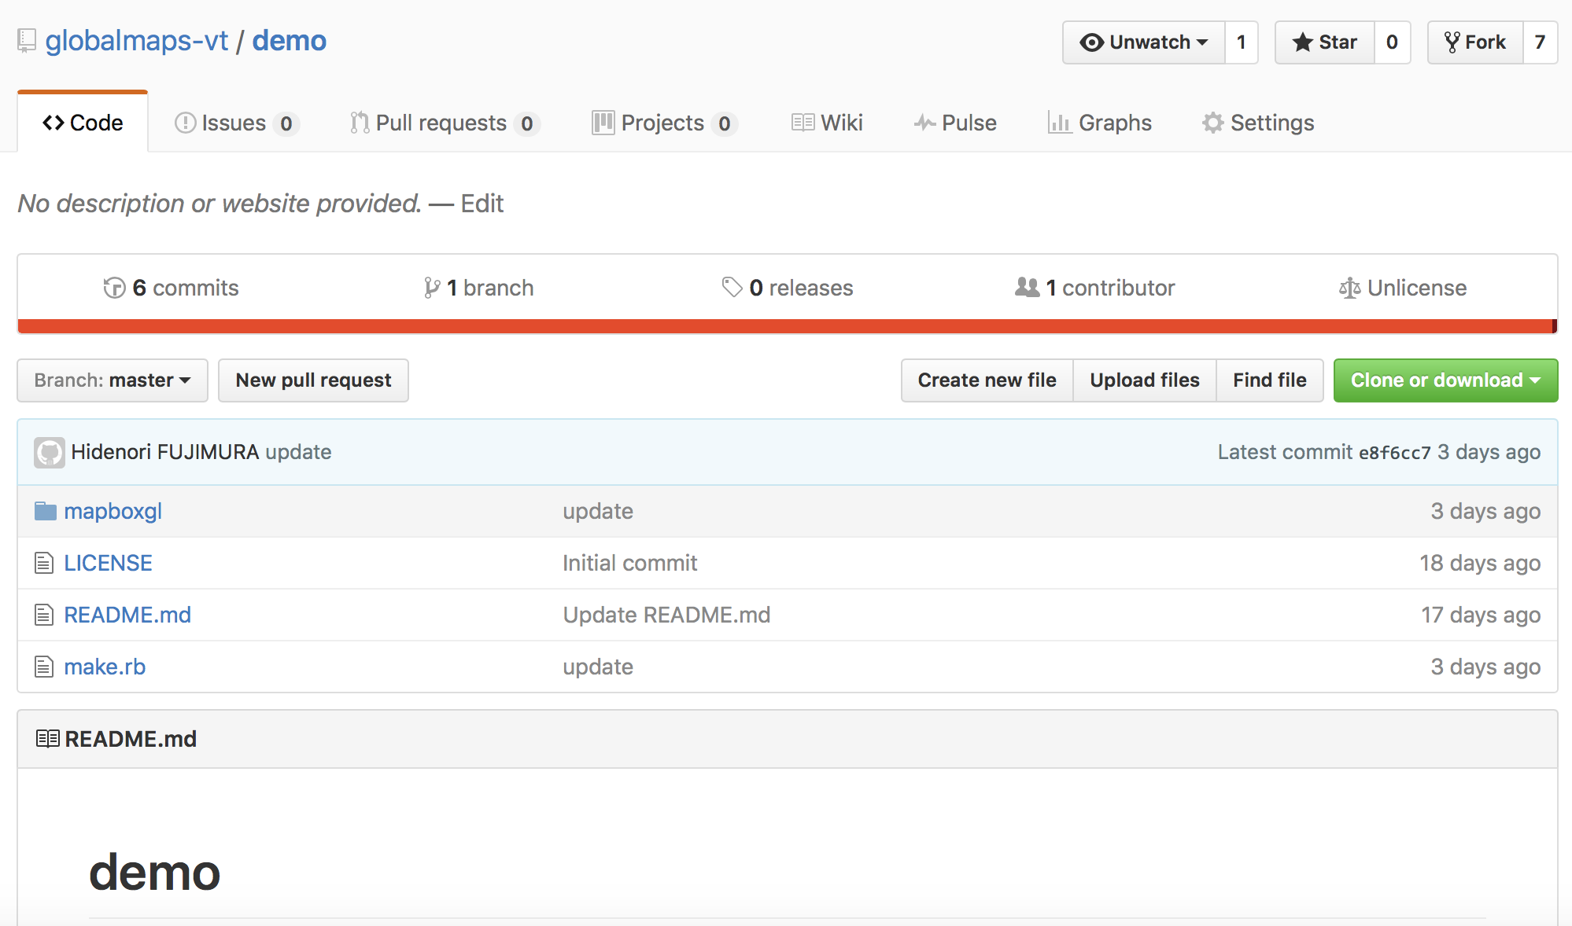
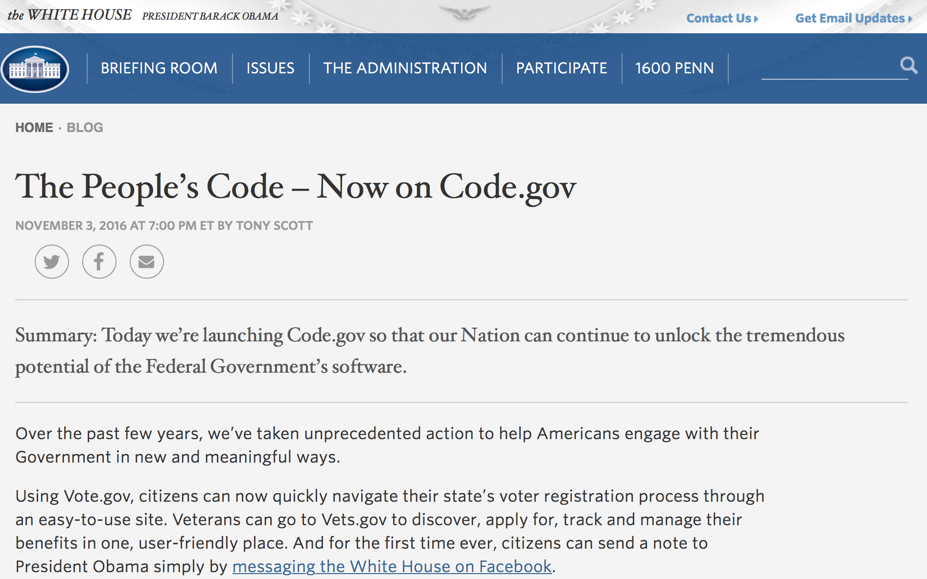
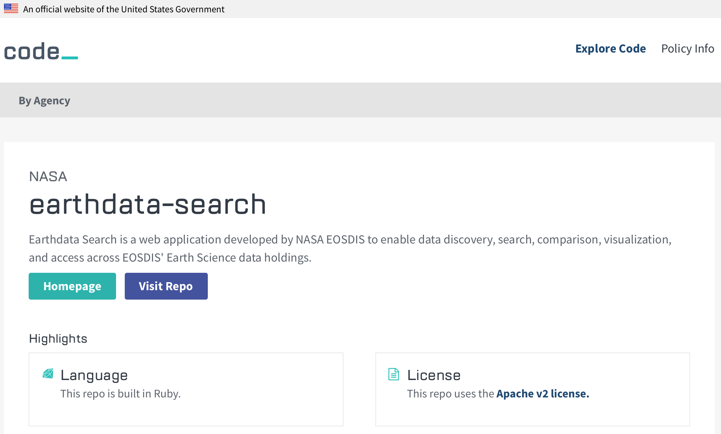
”code sharing” to promote governments’ business
https://github.com/gsi-cyberjapan/gsimaps
https://github.com/globalmaps-vt/demo

Slide 10
Summary
coordination
ownership
involvement
Let’s involve everyone and each other in order to catch up with technology trend, for wider and better application of our geospatial information.

